Slide 1
Logistisk regression

Slide 2
Logistic regression is a type of generalized linear model (GLM) for response variables where regular multiple regression does not work very well.
Ultimately, the application of a GLM will feel very similar to multiple regression, even if some of the details are different.

Slide 3
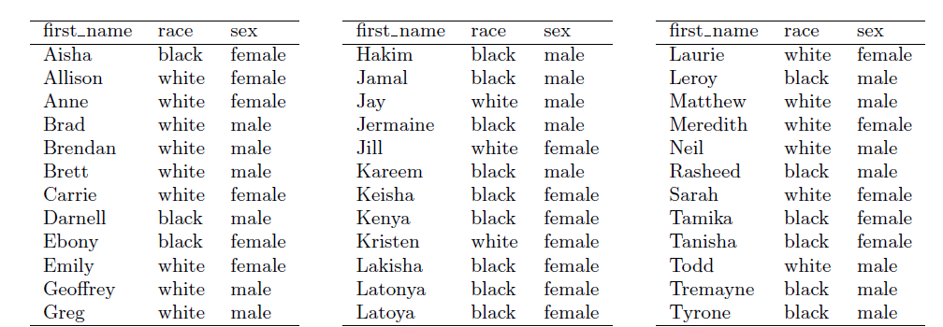
Eksempel

Slide 4
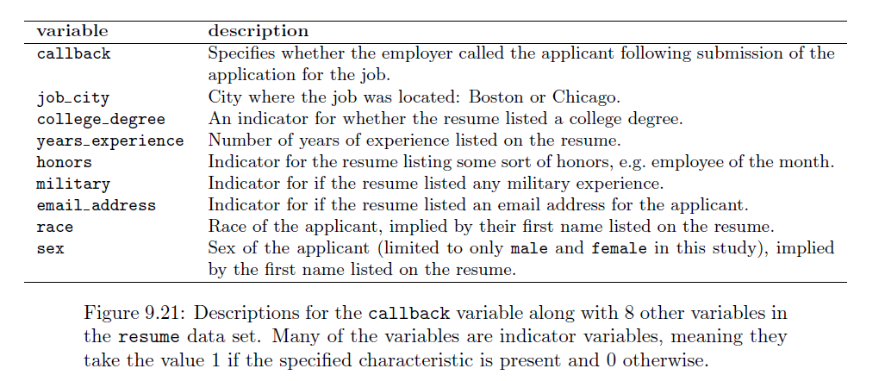

Slide 5
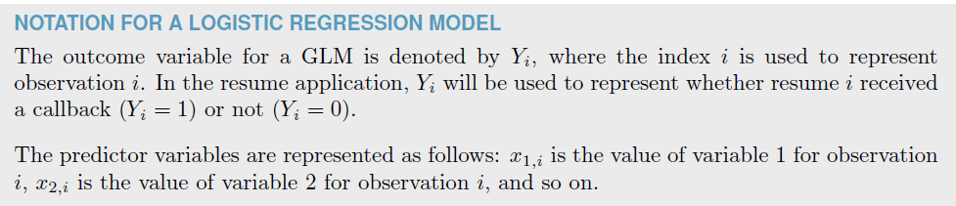


Slide 6


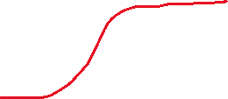


Hvis der IKKE er Honors
Hvis der er Honors

Slide 7
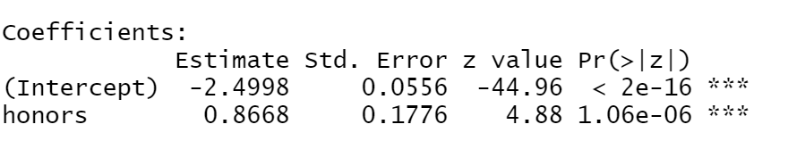
Hvordan I R?
Bare med en parameter
glm.fit <- glm(received_callback~honors, data=resume, family = binomial)
summary(glm.fit)

Slide 8
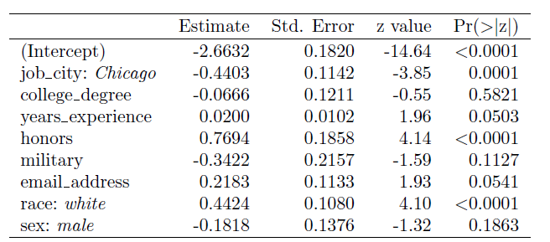

Slide 9
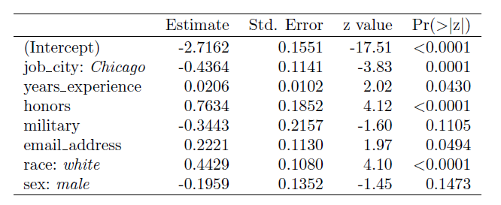

Slide 10
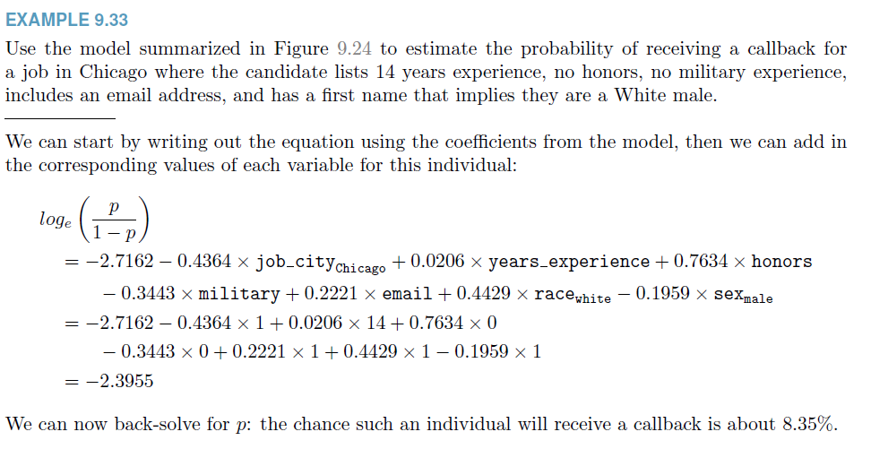

Slide 11
